Slide 1
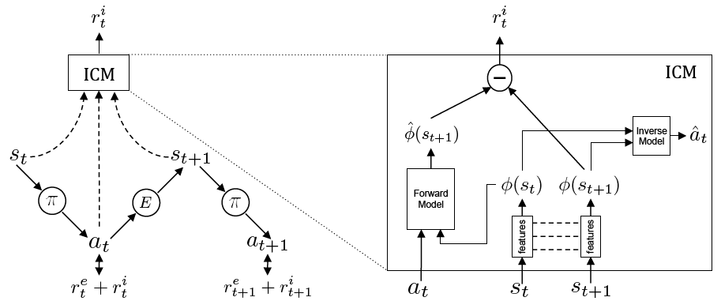
Curiosity-driven Exploration by Self-supervised Prediction

Slide 2
Abstract
In many real-world scenarios, rewards are extremely sparse.
Curiosity can serve as an intrinsic reward.
Curiosity: error in an agent’s ability to predict the consequence of its own actions learned by self-supervised inverse dynamic model.
“3-year-old has no trouble entertaining herself using intrinsic motivation or curiosity.”

Slide 3
Intrinsic Reward
How hard it is to predict the consequences of actions.
Encourage to explore ‘novel’ states.
- It requires a statistical model of the distribution of the environment states.
Encourage to perform actions that reduce the error/uncertainty in agent’s ability to predict.
-it requires building a model of dynamics.
It is an mechanism for an agent to learn skills that might be helpful in future scenarios.

Slide 4





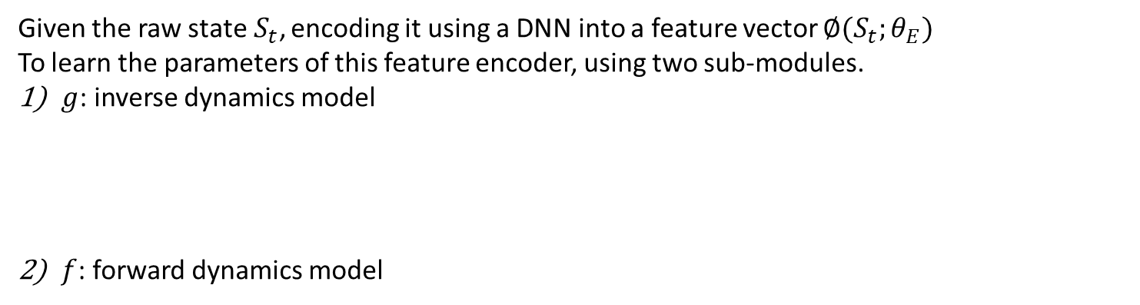
Intrinsic Reward
Self-supervised prediction for exploration
Given the raw state$S_{t}$, encoding it using a DNN into a feature vector $∅(S_{t};θ_{E})$
To learn the parameters of this feature encoder, using two sub-modules.
$g$: inverse dynamics model
$f$: forward dynamics model

Slide 5
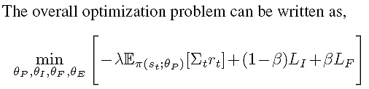
Intrinsic Reward
Self-supervised prediction for exploration

